Slide 1
3.1 Orchestration and Deployment
POSGRAD
MNA

Slide 2
Orchestration.

Slide 3
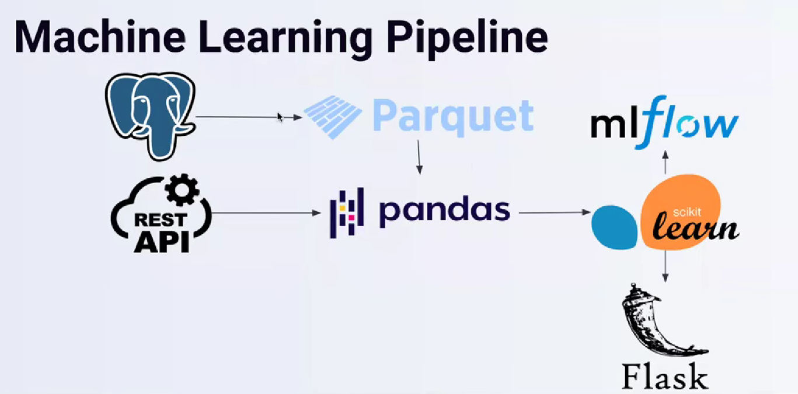
What is ML Orchestration?
Machine learning (ML) orchestration refers to the process of automating the deployment, management, and monitoring of machine learning models at scale. It coordinates the numerous facets and processes within an ML pipeline, such as data preprocessing, feature engineering, model training, validation, and deployment.

Slide 4
Machine learning orchestration automates and streamlines ML model development, helping businesses speed up time-to-market and improve ML operations' accuracy and efficiency. Orchestration platforms support various stages, including:
Version and data control
Model creation, testing, and validation
Model deployment and operation
Automated monitoring and alerting
Integration with other data and application services
These platforms free data scientists and engineers from infrastructure management, allowing them to focus on model development and improvement.

Slide 5
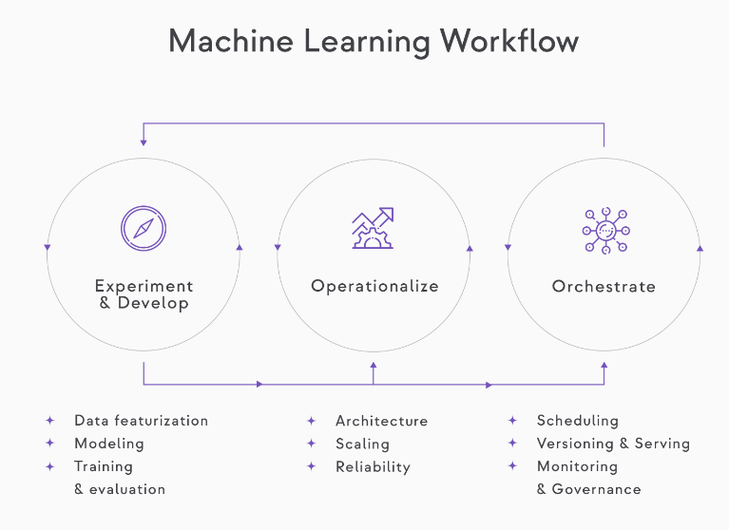
How a typical ML pipeline looks
If we want our ML pipeline to work well in production, its components must be orchestrated. The dependencies and data flow between them must be coordinated reliably, regularly, and observably.
This practice is known as machine learning orchestration (MLOx).

Slide 6
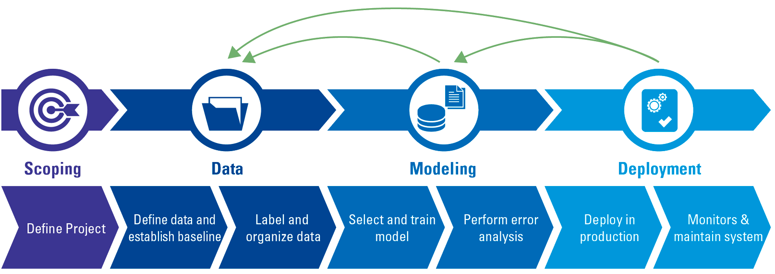
Operationalization and System Design
When moving to production, the following aspects must be considered:
Architecture and data flow
Scaling and scalability.
Availability and uptime
Security.

Slide 7
Orchestration Elements.
The orchestration tasks involve the following elements:
Scheduling
Syncing
CI/CD and testing
Saving and versioning
Retention and cleanup schedule
Monitoring
Data Drift
Concept Drift
Model Performance
System health and reliability tracking
Governance and Observability.

Slide 8
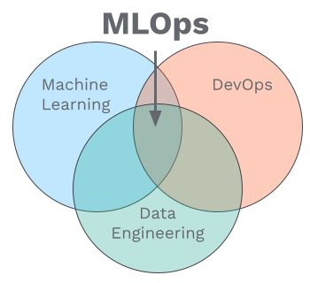
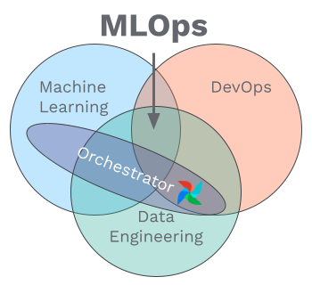
What is the difference between Orchestration and MLOps?
MLOps is a set of practices that combines Machine Learning, DevOps, and Data Engineering. It aims to reliably and efficiently deploy and maintain ML systems in production.
The orchestrator is an essential component in any MLOps stack, responsible for running your ML pipelines. The orchestrator provides an environment set up to execute your pipeline’s steps.
The orchestrator's role is to ensure that the various processes in the workflow execute on schedule, in the correct sequence, and deal appropriately with failure.

Slide 9
Deployment.

Slide 10
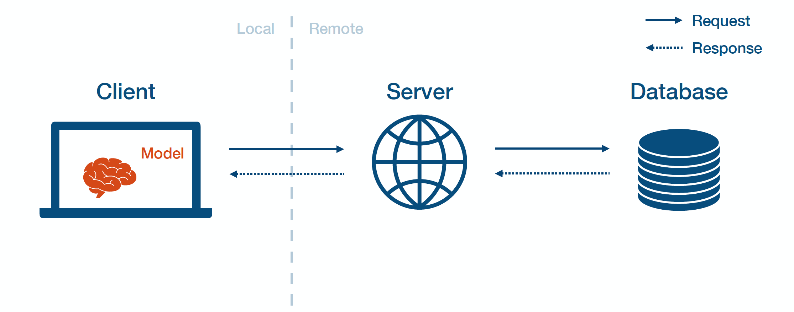
Introduction
Model deployment refers to integrating a trained machine-learning model into a real-world system or application to generate predictions or perform specific tasks automatically.
We may see that models that some models could have excellent performance in their development phase but once those are put into production, we could see issues like data skew, scalability inconsistencies and the sudden decrease of accuracy.

Slide 11
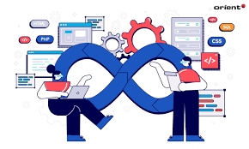
Important considerations.
ML pipeline deployment will depend on the following:
System environment.
Model type.
DevOps practices.
Scalability requirements.
Deployment is just as crucial as the development phase because ML pipeline deployment can only bring value to the organization once it faces real scenarios and deals with actual data.

Slide 12
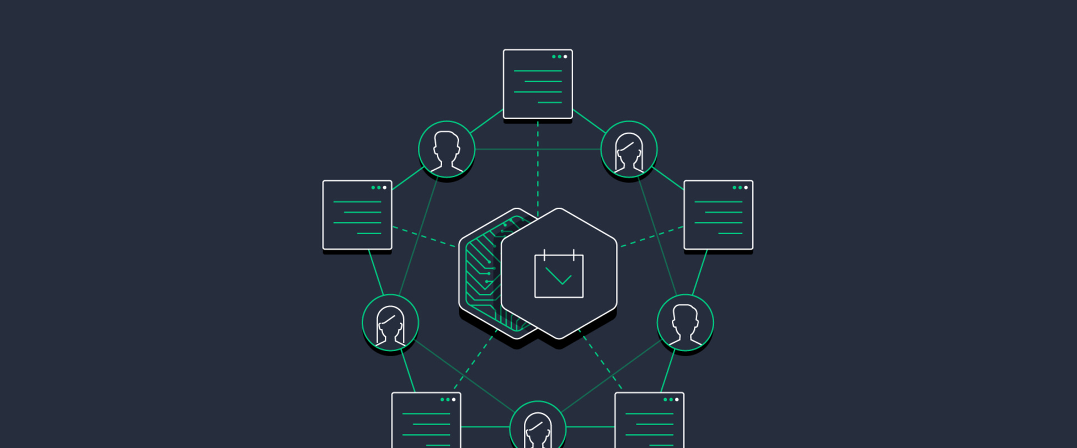
ML Pipeline Deployment Criteria.
Before deploying a model, there are a couple of criteria that your ML pipeline needs to achieve before it’s ready for deployment:
Portability: This is the ability of your software to be transferred from one machine or system to another.
Scalability: This refers to how large your model can scale. A scalable model is one that doesn’t need to be redesigned to maintain its performance

Slide 13
ML Pipeline Arquitecture
As we have seen, there are four layers in an ML pipeline.
Data Layer: It provides access to all the data sources the model will require.
Feature Layer: Is responsible for generating feature data in a transparent, scalable, and usable manner.
Scoring Layer: It transforms features into predictions. Scikit-learn is most commonly used and is the industry standard for scoring.
Evaluation Layer: It checks the equivalence of two models and can be used to monitor production models.

Slide 14

ML Deployment Process
As we have seen during the course, the process of model deployment involves several steps, but we can redefine the Deployment stage to include the next steps:
Model serialization.
Deployment environment preparation
Deployment API building
Deployment testing and validation
ML pipeline deployment

Slide 15

Model Serialization.
Once you have chosen the best model, it´s crucial to serialize and save it for further use. Serialization converts the model into a binary format that can be stored on disk. The joblib library is commonly used for model serialization in Python.

Slide 16

Deployment Environment Preparation.
To deploy your model, you need to set up the deployment environment, this means that you need to create a virtual environment that manage the dependencies and install the required libraries. This ensures that your deployment environment is isolated and has the required packages installed.

Slide 17
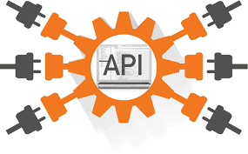
Deployment API Building.
You must create a python script that defines the API endpoint that will handle the incoming request, preprocess and make the predictions.

Slide 18
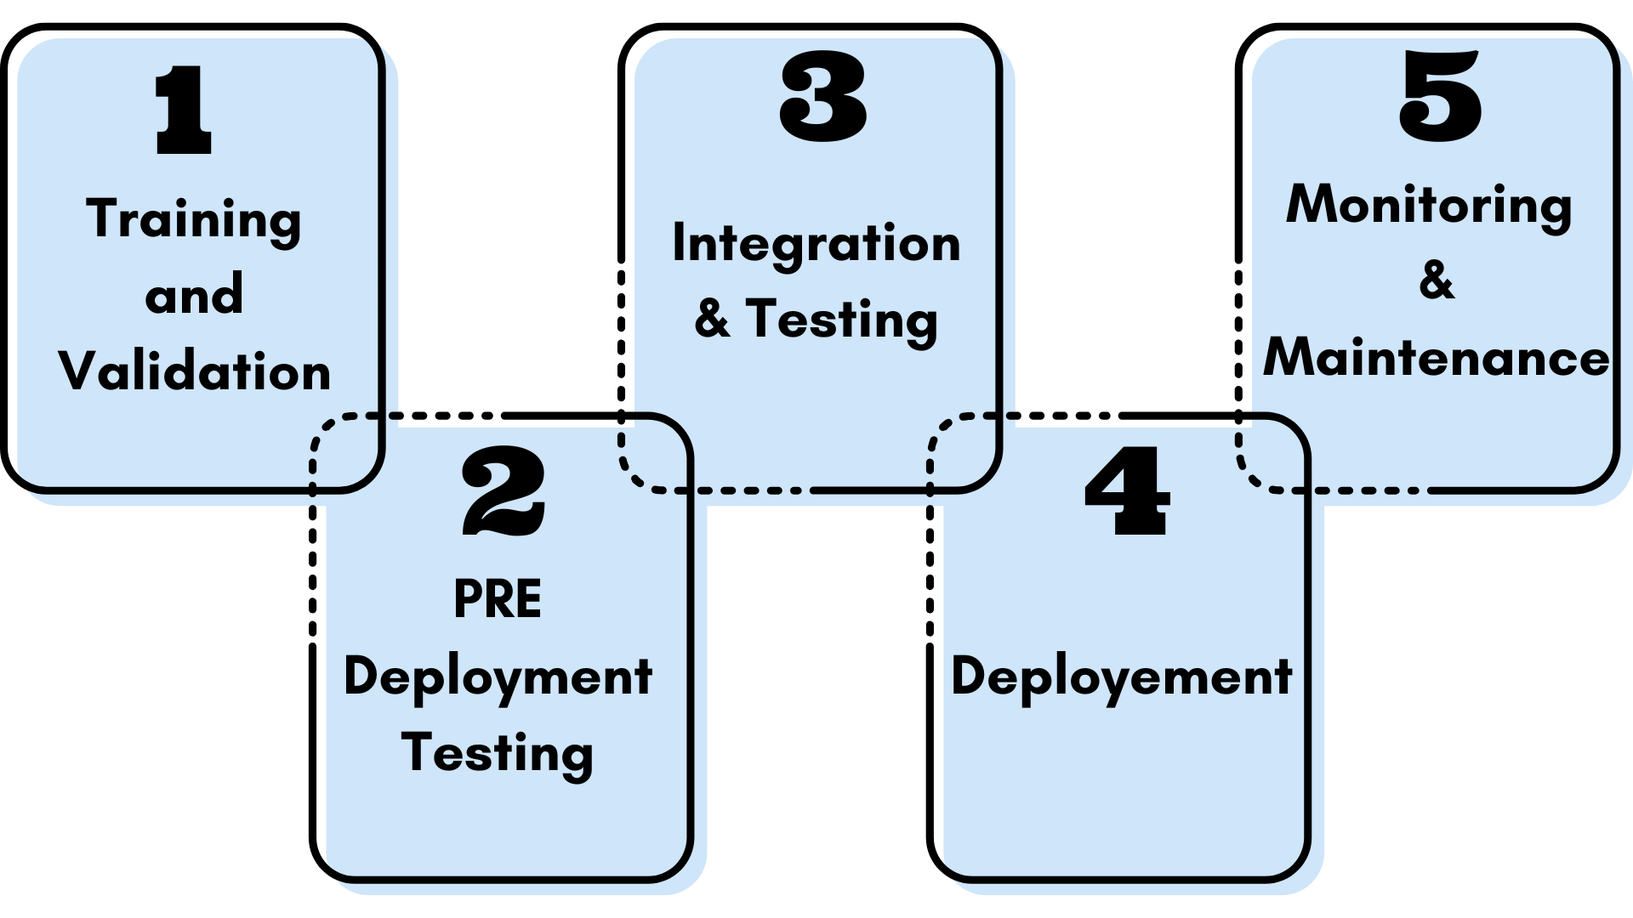
Deployment Testing and Validation
This step involves sending sample requests to the API using tools like requests or curl and verifying the output against expected results during model monitoring. You must further compare the predictions made by the deployment with those made during model development to ensure consistency and accuracy across multiple models.

Slide 19
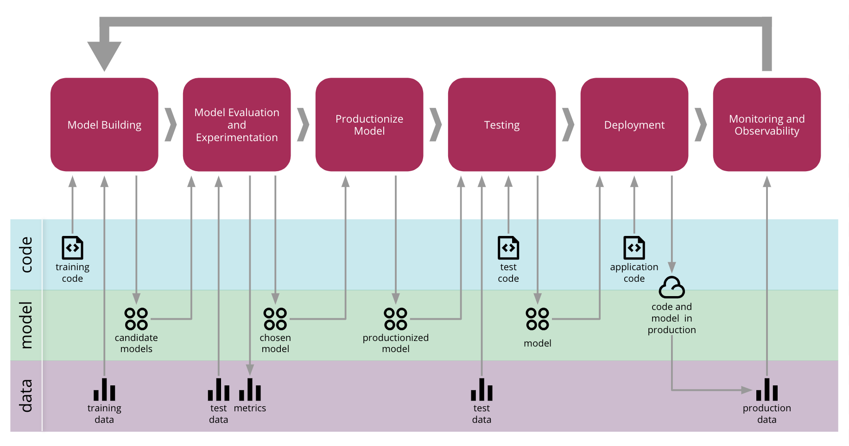
ML Pipeline Deployment
You must choose a server or cloud platform to deploy your ML application, such as Heroku, AWS, or Azure, as they provide the necessary infrastructure to host your deployment. You must also configure the server/cloud environment to handle incoming requests and route them to the API endpoint you defined in the previous step. When deploying your ML model in a production environment, you must always follow best practices for security, scalability, and availability.

Slide 20
Deployment Methods and Patterns.

Slide 21
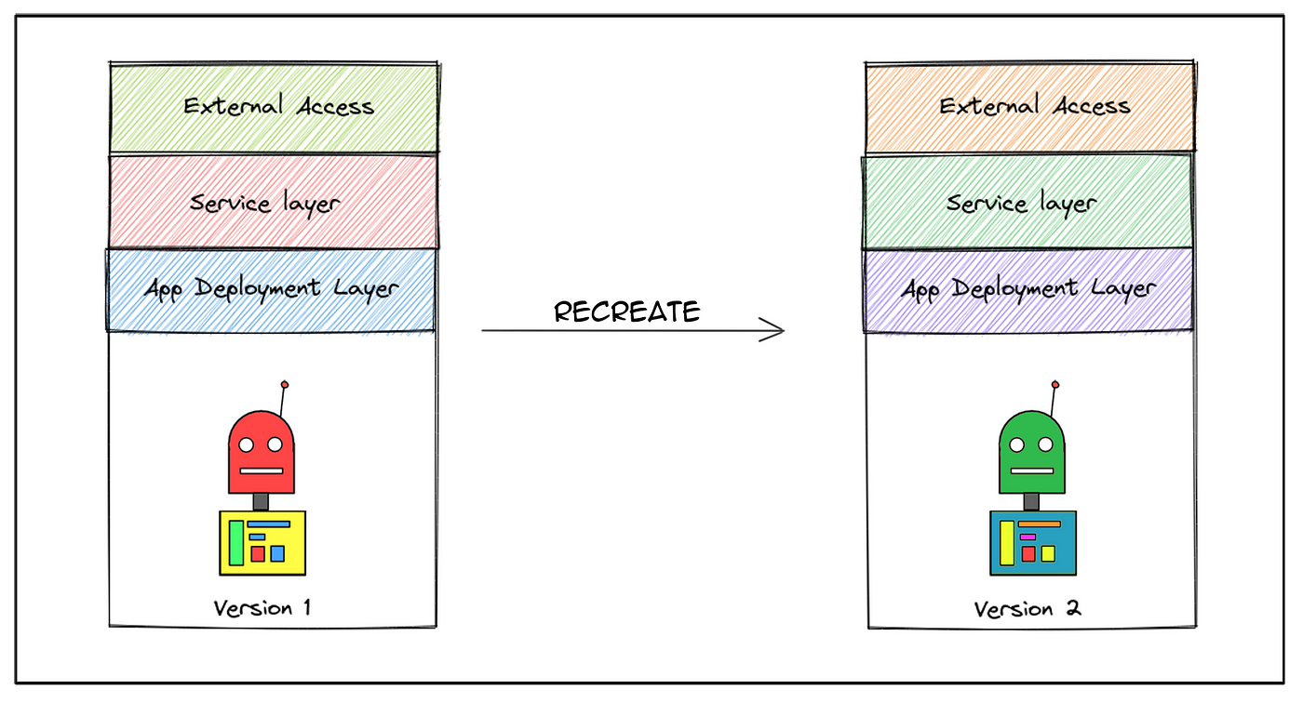
Deployment Methods.
These are techniques employed by DevOps teams to successfully launch a new version of the software solution they provide.
For Machine Learning pipelines, it refers to the method used to make the up-to-date model available for its users.

Slide 22
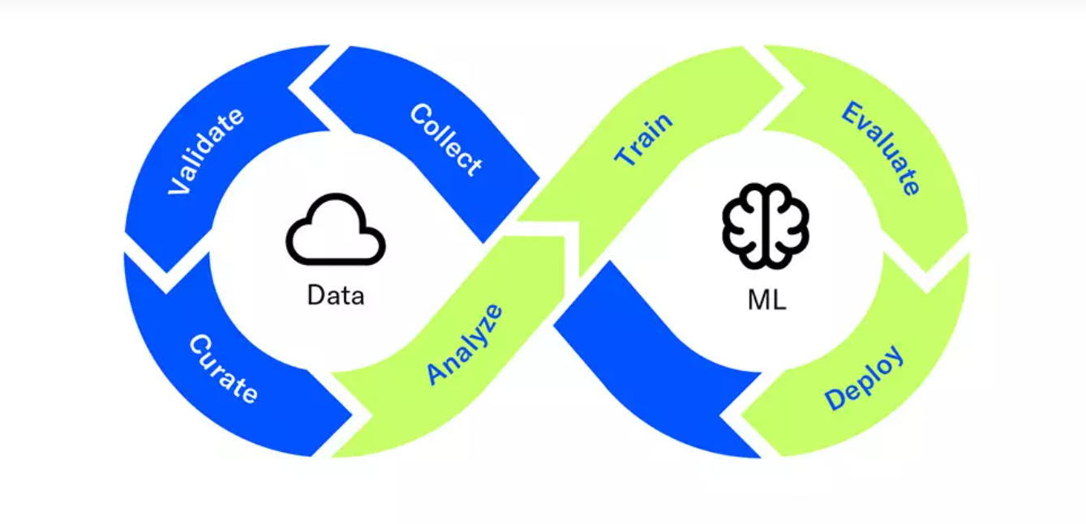
Deployment Patterns.
These are automated methods for introducing new application features to your users.
Deployment patterns enable you to test new features with a small group of users before making them available to everyone.

Slide 23
Deployment Methods.

Slide 24

One-off.
Sometimes, you don’t need to continuously train a machine learning model to deploy it; it is only needed once or periodically.
In this case, the model can simply be trained ad-hoc when it’s needed and pushed to production until it drifts enough so you need to fix it.

Slide 25
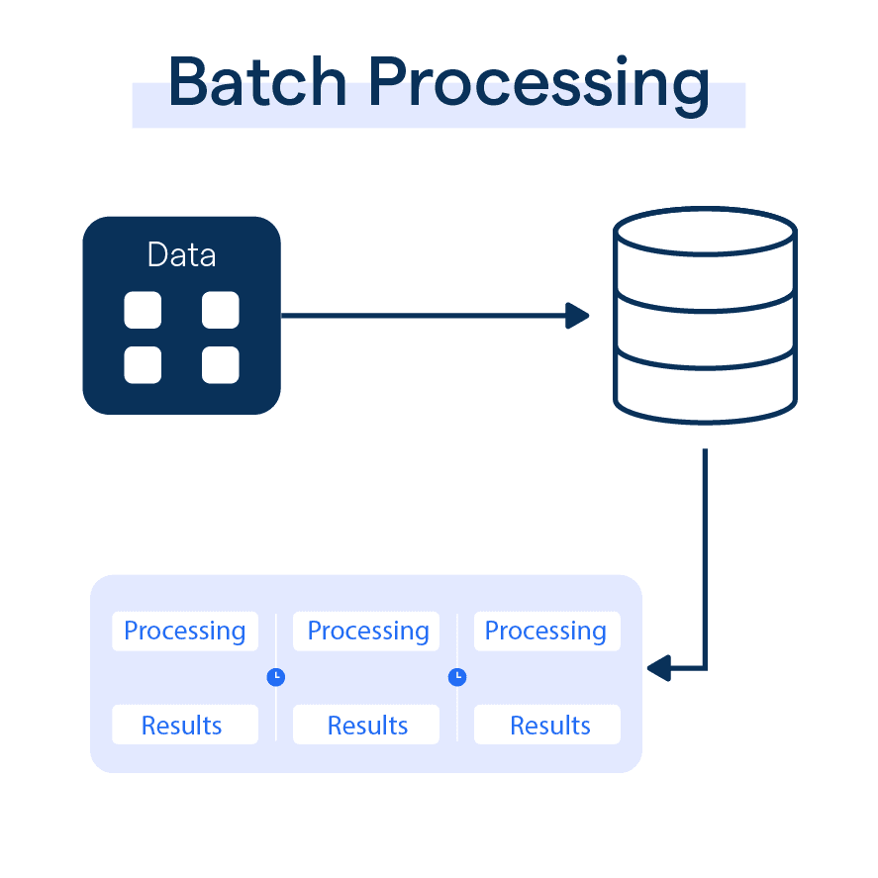
Batch.
Batch training enables you to maintain an up-to-date version of your model continuously. This scalable approach uses a subset of the data for each update, avoiding the need to process the entire dataset every time. It's ideal if you regularly rely on the model but don't require real-time predictions

Slide 26
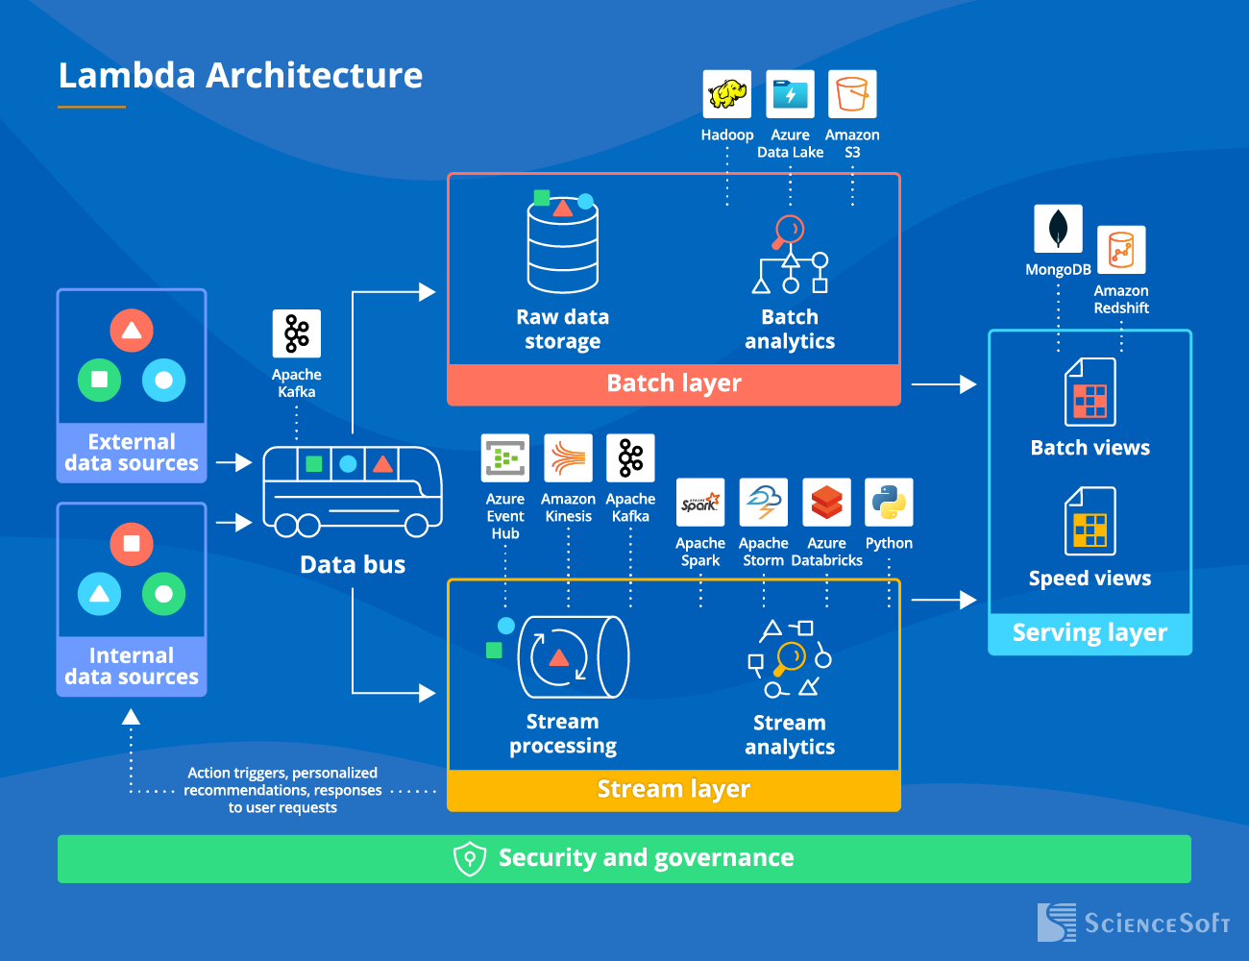
Real time.
In certain situations, real-time predictions are essential, such as identifying whether a transaction is fraudulent. This can be achieved by using online machine learning models, like linear regression with stochastic gradient descent.

Slide 27
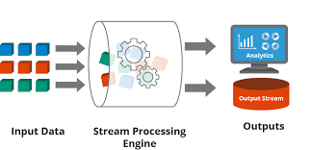
Streaming.
Streaming deployment supports a more asynchronous workflow, allowing user actions to trigger prediction computations.
To implement this, the process is connected to a message broker, and the model handles requests as they become available.
This method decreases server load and optimizes computational resources by using an efficient queuing system.

Slide 28
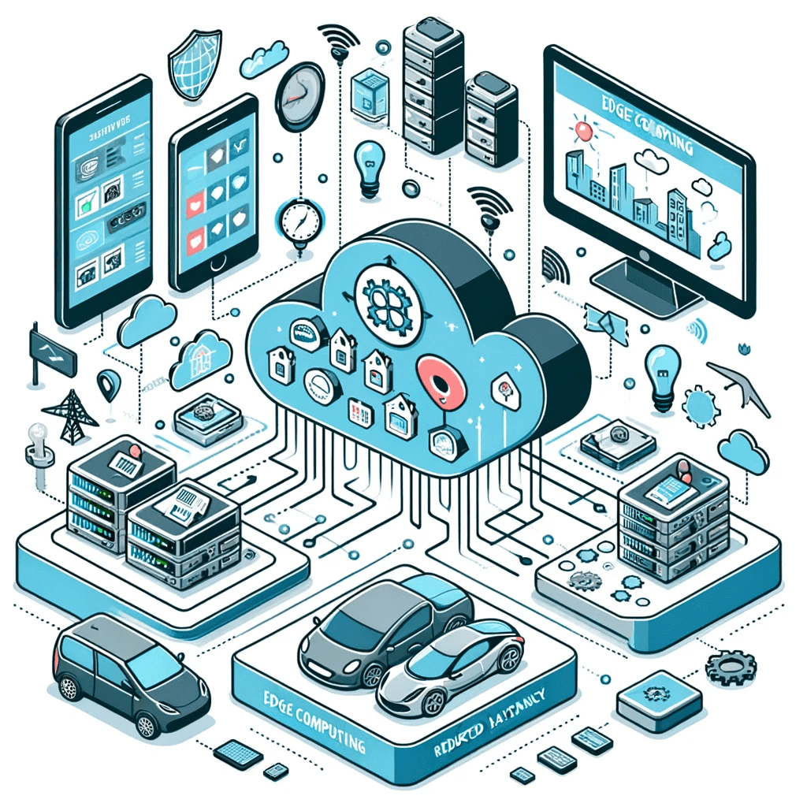
Edge.
Edge deployment allows for faster model responses and offline predictions.
In this approach, the model is deployed directly on a client device, such as a smartphone or IoT device.
To make this feasible, models typically need to be compact enough to run on a smaller device.

Slide 29
Deployment Patterns.

Slide 30
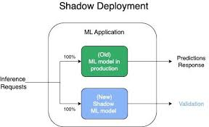
Shadow Deployment.
The new model is deployed with additional features alongside the active model, known in this case as a shadow model.
The shadow model processes all requests like the live model, but it isn’t publicly accessible.
This approach allows for evaluating the shadow model on real-world data without disrupting the services provided by the live model.

Slide 31
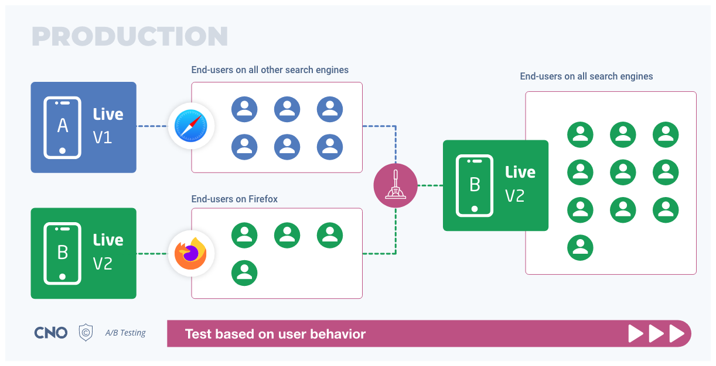
A/B Testing.
This is a data-driven testing method used to compare two models, A and B, to determine which performs better in a controlled setting.
Through A/B testing, data scientists can assess and select the optimal website design based on user data.
The two models have slight feature differences and are targeted at different user groups.

Slide 32
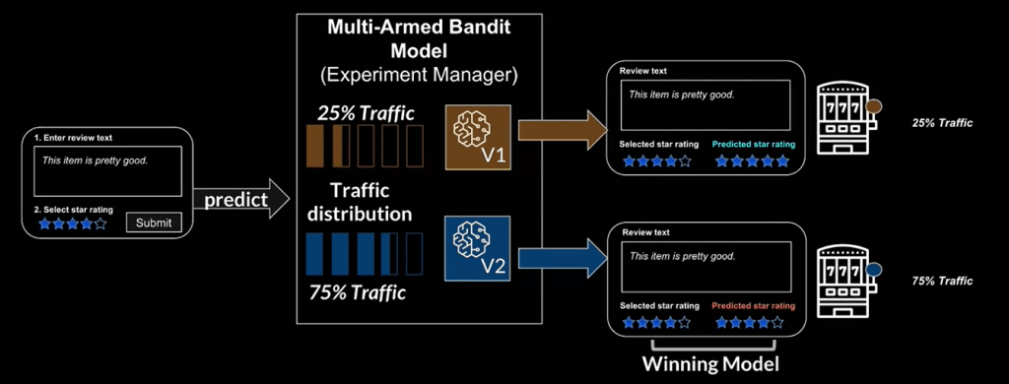
Multi-Arm Bandits.
The Multi-Armed Bandit (MAB) is an advanced approach to A/B testing.
Drawing inspiration from reinforcement learning, it aims to balance exploration and exploitation to maximize the reward function.
MAB uses machine learning to optimize key performance indicators (KPIs), deploying the model that delivers the highest KPI across all users.

Slide 33
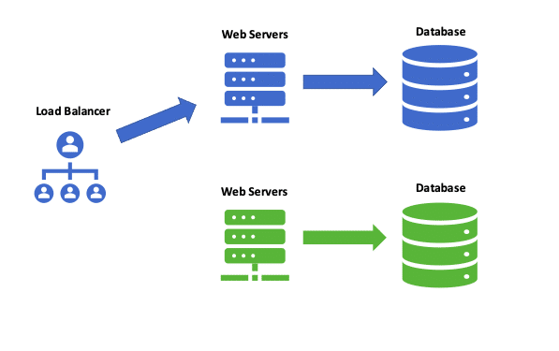
Blue-Green Deployment.
The Blue-green deployment strategy uses two production environments rather than only models.
The blue environment hosts the live model, while the green environment contains the updated model version.
The green environment serves as a staging area with new features.
Once updates are tested and validated, user requests are redirected to the new environment, effectively replacing the old model with the new one.

Slide 34
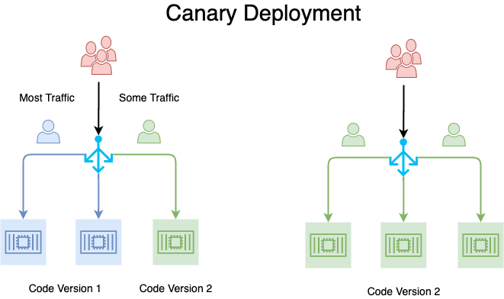
Canary Testing.
The canary release is a technique for identifying potential issues before they impact all users.
In a canary deployment, the new model version is released by gradually increasing the number of users.
This deployment strategy uses real users to test the new model.
Consequently, bugs and issues can be detected before rolling out the model globally.

Slide 35
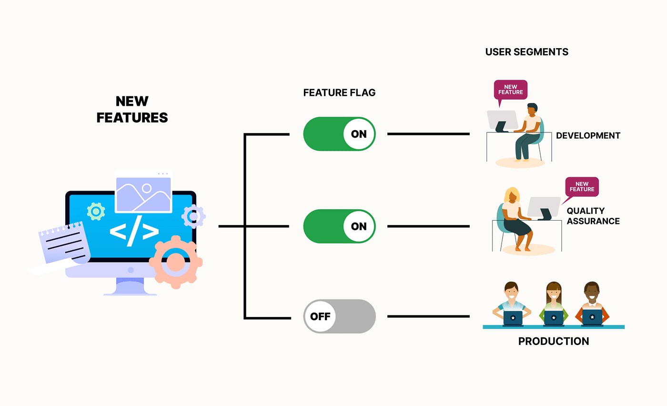
Feature Flag.
The feature flag is a technique that allows developers to merge code into the main branch while keeping specific features inactive.
The goal is to keep the feature dormant until it’s fully ready, enabling collaboration on various ideas and iterations. Once the feature is complete, it can be activated and deployed.

Slide 36
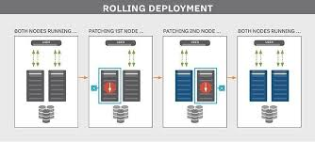
Rolling Deployment.
The Rolling deployment is a strategy that gradually updates and replaces the older version of the model.
Rolling updates involve updating all instances of your model or application.
One by one the older pods are replaced with newer ones. There is no downtime with this approach.

Slide 37
Model Packaging and Serving.

Slide 38
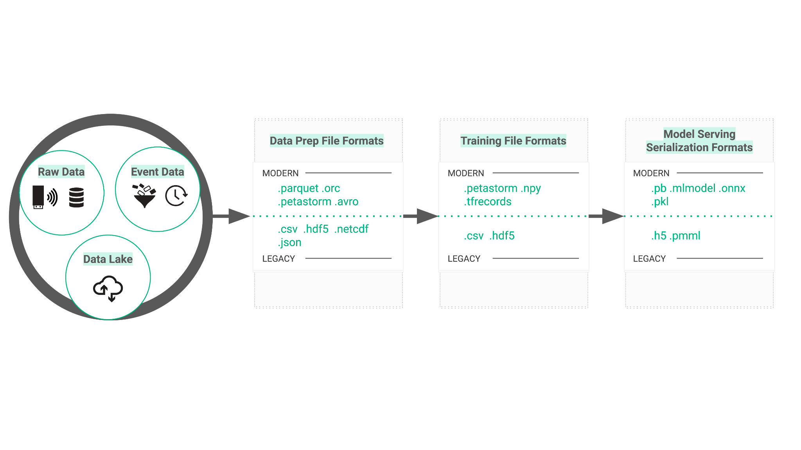
What is model packaging?
Model packaging bundles model artifacts, dependencies, configuration files, and metadata into a unified format for easy distribution, installation, and reuse. The primary goal is to streamline model deployment, ensuring a smooth transition to production.

Slide 39
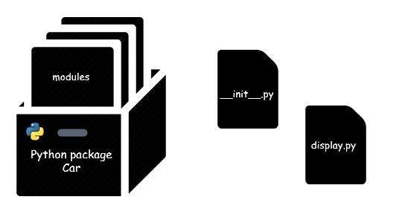
Why is it important?
Model packaging ensures a machine-learning pipeline can be easily deployed and maintained in a production environment. When it is done correctly, it ensures:
A well-packaged model is easy to install, which reduces the time and effort required for deployment.
Ensures reproducibility across different environments, providing consistent results.
Model packaging makes it easier to version models, track changes, and roll back to previous versions if needed.
It includes clear code documentation that helps your peers understand how to use and modify it if required.

Slide 40

Challenges of creating a model package.
Packaging our ML pipelines is helpful when putting our ML models into production, however, it comes with some challenges as well:
Model complexity.
Environment diversity.
Collaboration across teams.
Dependency management.

Slide 41
There are a couple of considerations when packaging ML pipelines:
Web-based frameworks.
These are code libraries that makes web development faster, efficient and easier by providing common patterns for building reliable, scalable and maintainable web applications. Some examples of this are Flask, Django and FastAPI.
MLOps tools.
You can rely on tools that take some of the heavy lifting for this process, some examples are:
Azure ML
GCP Kubeflow
AWS Sagemaker
ONNX
Tensorflow Serving

Slide 42
Model Serving Options.

Slide 43
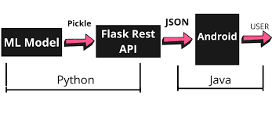
Model Embedded in the App.
The most straightforward way to integrate your model into an application is through model embedding. This approach involves embedding the model file within the application code, allowing the application to access it directly.

Slide 44
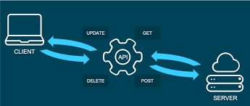
Model Served as an API.
This architecture separates the application from the model via an API, streamlining organizational workflows, model versioning, reuse, phased updates, and hardware independence. It enables the application and model server to use different hardware (CPU, GPU, FPGA) and scale independently based on demand.

Slide 45
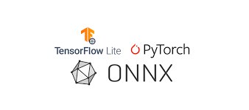
Model saved and used as a Library.
In this approach, the model is saved in a standardized format (such as TensorFlow SavedModel, PMML, PFA, or ONNX), making it programmatically accessible to any modern programming environment, language, or framework and enabling reuse across various applications.

Slide 46
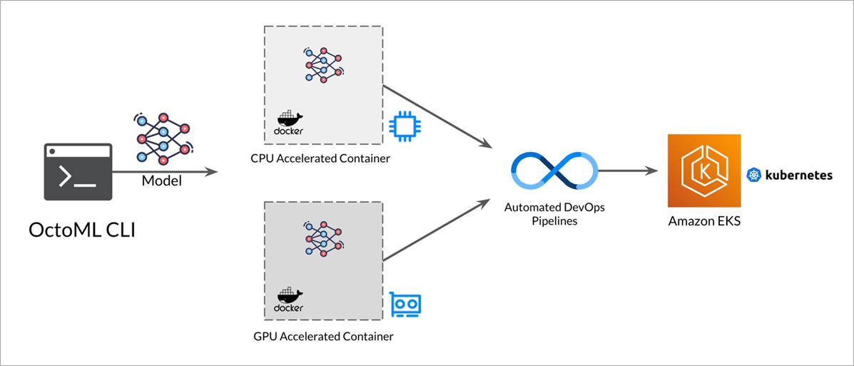
Model saved in containers.
Containerization technologies like Docker and Kubernetes have transformed the way developers and organizations package, deploy, and manage applications. These tools have gained popularity due to their ability to package applications conveniently, eliminating concerns about dependencies and infrastructure. Their use has also expanded into machine learning, where developers leverage them to package and deploy ML models.

Slide 47
Intro to Docker

Slide 48
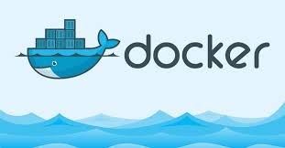
Docker Intro
Docker is a software platform that enables the rapid creation, testing, and deployment of applications. Docker packages software into standardized units called containers, which include everything needed to run the software, such as libraries, system tools, code, and runtime environments.
Docker provides a standardized way to run your code. It acts as an operating system for containers. Similar to how a virtual machine abstracts server hardware, containers abstract the server's operating system. Docker is installed on each server and offers simple commands to create, start, or stop containers.

Slide 49
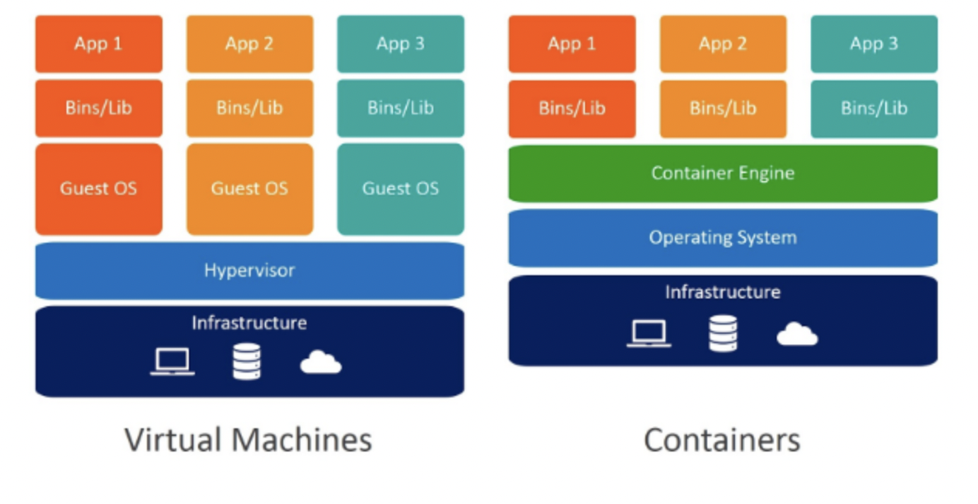
Virtualization vs Containerization

Slide 50
Issues with Virtual Machines
Size: Duplicates standard files, leading to slow startup.
Maintenance Cost: Requires maintenance, similar to any other computer.
Multiple Formats: VID, VHD, raw, etc.
Advantages of containers
Flexibility: Any application can be containerized.
Lightweight: Containers use the host OS kernel.
Portable: Run consistently on any machine.
Scalable: Easily create more containers with identical functionality.
Secure: A container can control access to system areas.

Slide 51
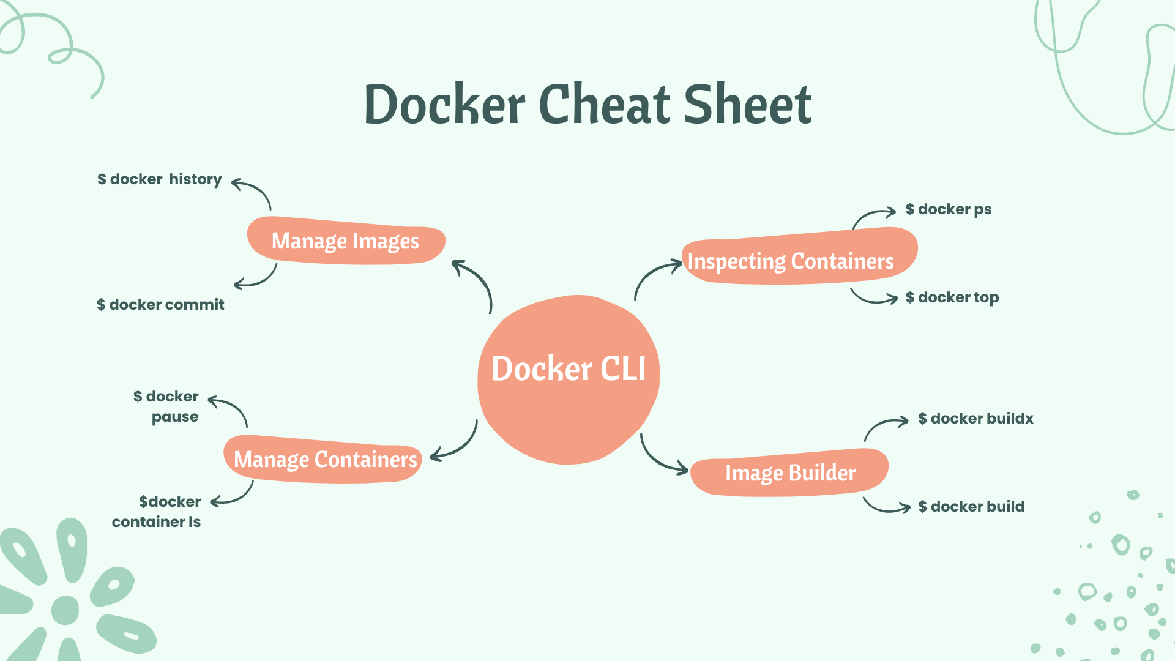
To package an ML model using Docker, follow the next steps:
Create a Dockerfile.
Build the Docker image.
Push the Docker image to a registry.
Pull the Docker image from the registry.
Run the Docker container.

Slide 52
References.

Slide 53
For further reference:
ML Model Packaging
Machine Learning Pipeline Orchestration
Machine Learning Orchestration vs MLOps
ML Workflow and Pipeline Orchestration Tools

